Slide 1
Introduction: Cardiovascular Health Project

Slide 2
Introductions!

Slide 4
Why Cardiovascular Health?

Slide 5
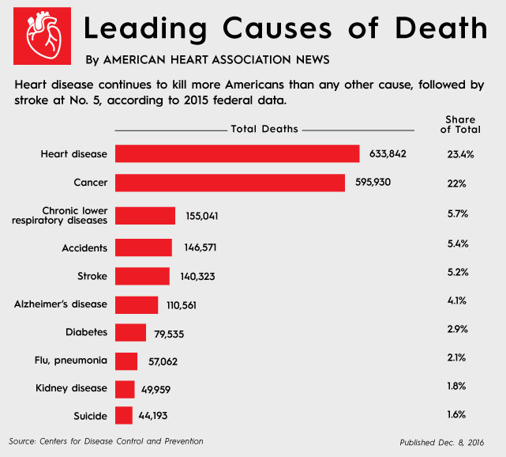
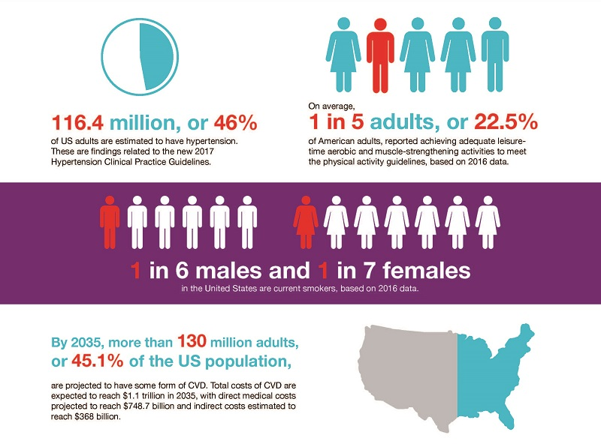
American Heart Association
Although a lil out of date as of today*

Slide 6
Cardiovascular Health
An important element in our daily lives, where exercise and nutrition can reduce heart disease and heart failure rates.
Data science can help us understand more with populations, and early detection can prevent unhealthy habits.

Slide 7
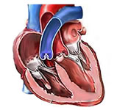
Heart Disease Dataset
UCI Machine Learning Repository: Heart Disease Data Set

Slide 8
Heart Failure Dataset
Cardiovascular-Health-Project
Machine learning can predict survival of patients with heart failure from serum creatinine and ejection fraction alone | BMC Medical Informatics and Decision Making

Slide 10
Project Structure
Partner Based Project
Walkthroughs + Guides
Weekly Check-in Meetings (~1 hr)

Slide 11
Tools to use:
Google Colab (Most Convenient)
CoCalc (Real-Time Collaboration)
Anything else you prefer! (e.g. Jupyter on datahub, IDEs like Atom/VS Code)

Slide 12
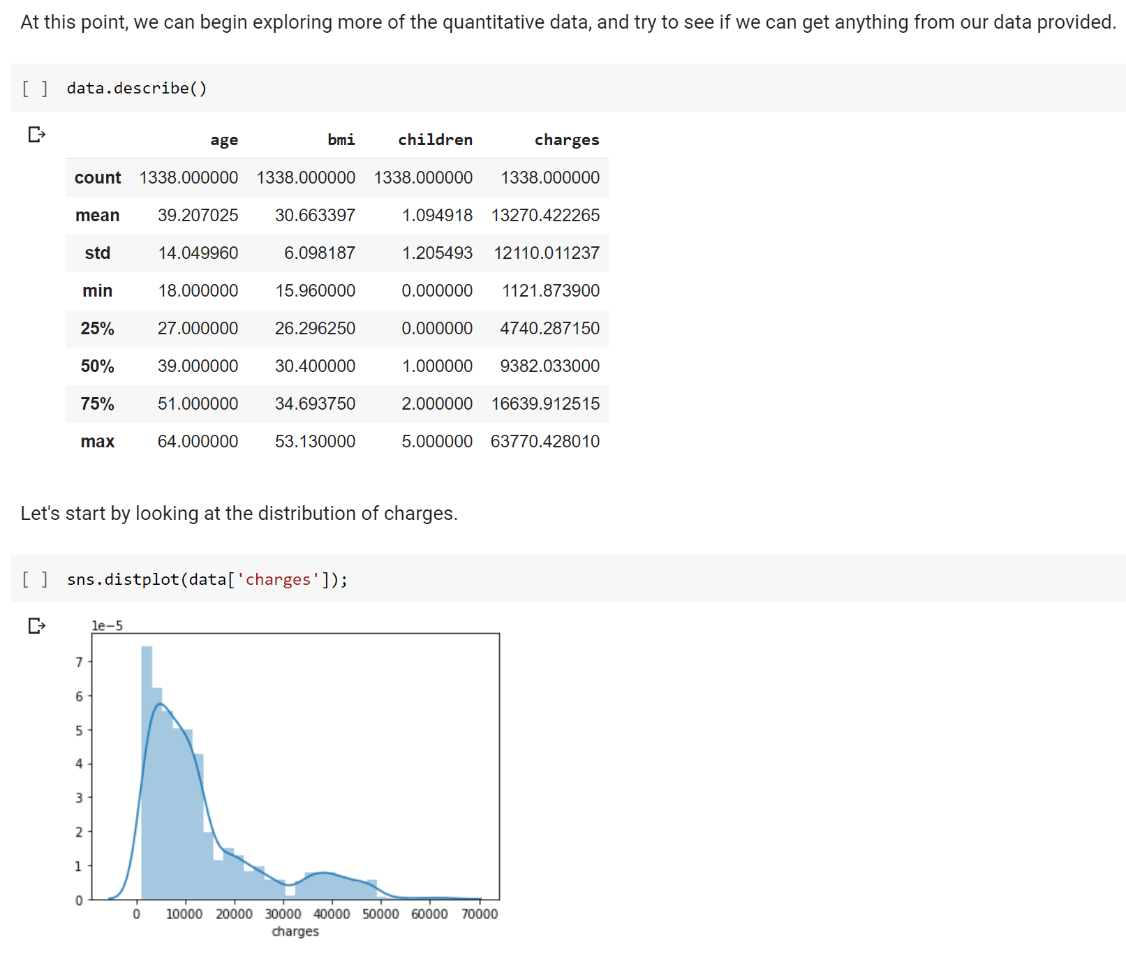
Example Walkthrough

Slide 13
Topics (Tentative)
EDA + Visualization
Modeling and Regression
Advanced Modeling Techniques (RF, Gradient Boosting, PCA)

Slide 14
RESOURCES
Heart Disease UCI
Heart Disease Dataset (seems like the same dataset)
UCI Machine Learning Repository: Heart Disease Data Set (original source)
Classification models for heart disease prediction using feature selection and PCA (Research paper that uses the same dataset with detailed descriptions)
Heart Failure Prediction
Machine learning can predict survival of patients with heart failure from serum creatinine and ejection fraction alone | BMC Medical Informatics and Decision Making (paper from which the dataset comes from)

Slide 15
Recording Link: https://berkeley.zoom.us/rec/share/wpvwJ3T_YLklNu121uvP5Hj7zcTydzKAh_-ohRBQzgwHPO9I6sFqhO-E2IkNZwdp.FdWbxaHZztwy0lWg

